Slide 1

Wireless Network Proposal
Khushi Bajaj(145), Ankit Kumar(169), Malavika v(152), Sutirtha(183)

Slide 2
Content List
Problem Statement
Network Topology Diagram
IP Network Design Table
Network Testing & Verification
Conclusion
Bibliography

Slide 3
Problem Statement
The task is to create a wireless network proposal has to be prepared for setting up a
wireless VLAN based infrastructure at a campus. The campus has 3 departments,
management, research and finance.
Each department has approximately 30 users. ADSL internet connection is available in the campus, which needs to be shared by the all the users in the different departments. Wireless access to the network should be available using access points installed at strategic locations.

Slide 4
Problem Statement (Cont.)
Users should also be able to access the network through computers using LAN connectivity. Files servers should be setup on the network for users in the departments to share and transfer files. Guest users should be able to connect to the internet through the wireless access points, without any authentication. Users in each department should have a common password, which should be used for gaining access to the network through the wireless access points. The guest users should not have access to the file server installed on the network. Dynamic IP addressing system should be available from a single DHCP server to allocate IP address to all departments users and guests. Users should be able to connect to the appropriate departments, highlighted through appropriate names on the access point. Appropriate equipment for internet sharing should be made available.

Slide 5
Requirement and Analysis
Hardware Requirements
Processor : 2.4 GHz Clock Speed
RAM : 1 GB
Hard Disk : 500 MB (Minimum free space)
Software Requirements
Operating System : Windows 7
Platform : Java
Back End : MySql
Special Tools : Opencv, Xuggle
Server : Apache Tomcat

Slide 6
Hardwares
Routers: A router is a networking device that forwards data packets between computer networks. Routers perform the traffic directing functions on the Internet.
Switches: A network switch (also called switching hub, bridging hub, and, by the IEEE, 1 MAC bridge) is networking hardware that connects devices on a computer network by using packet switching to receive and forward data to the destination device.
DHCP server A DHCP Server is a network server that automatically provides and assigns IP addresses, default gateways and other network parameters to client devices. It relies on the standard protocol known as Dynamic Host Configuration Protocol or DHCP to respond to broadcast queries by clients.

Slide 7
Softwares
Cisco Packet Tracer (V8.0.0)- Cisco Packet Tracer as the name suggests, is a tool built by Cisco. This tool provides a network simulation to practice simple and complex networks. The main purpose of Cisco Packet Tracer is to help students learn the principles of networking with hands-on experience as well as develop Cisco technology specific skills. Since the protocols are implemented in software only method, this tool cannot replace the hardware Routers or Switches. Interestingly, this tool does not only include Cisco products but also many ore networking devices.

Slide 8
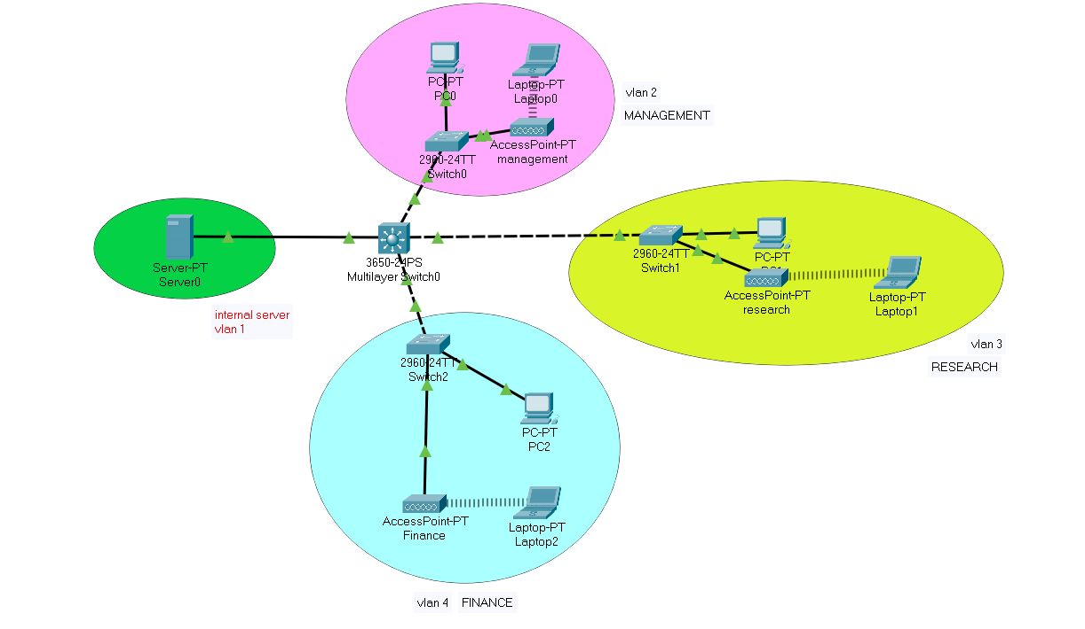
Network Topology Diagram

Slide 9
IP Network Design Table
VLAN | IP | Subnet
Vlan1 | 192.168.1.1/24 | 255.255.255.0
Vlan2 | 192.168.2.1/27 | 255.255.255.0
Vlan3 | 192.168.3.1/27 | 255.255.255.0

Slide 10
IP Network Design Table (Cont.)
VLAN | Device | IP | Subnet | Gateway
Vlan1 | PC0 | 192.168.2.2 | 255.255.255.0 | 192.168.2.1
 | LAPTOP 0 | 192.168.2.3 | 255.255.255.0 | 192.168.2.1
Vlan2 | PC1 | 192.168.3.2 | 255.255.255.0 | 192.168.3.1
 | LAPTOP 1 | 192.168.3.3 | 255.255.255.0 | 192.168.3.1
Vlan3 | PC2 | 192.168.4.3 | 255.255.255.0 | 192.168.4.1
 | LAPTOP 2 | 192.168.4.2 | 255.255.255.0 | 192.168.4.1
Vlan4 | SERVER-PT | 192.168.1.2 | 255.255.255.0 | 192.168.1.1

Slide 11
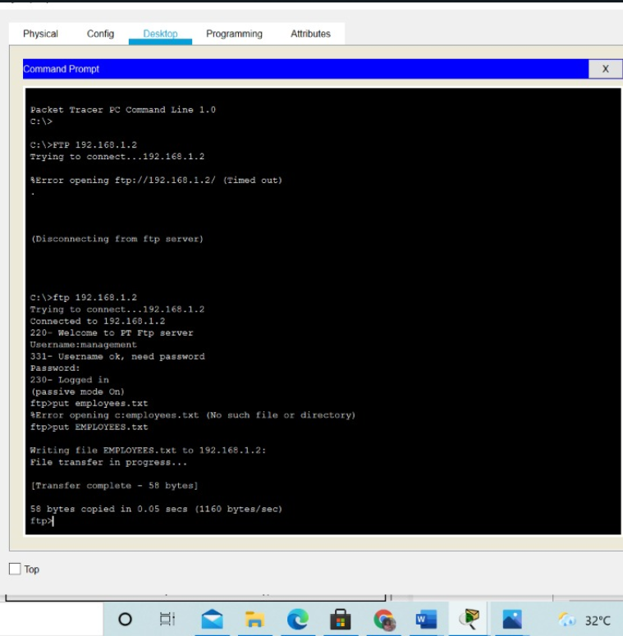
Network Testing & Verification

Slide 12
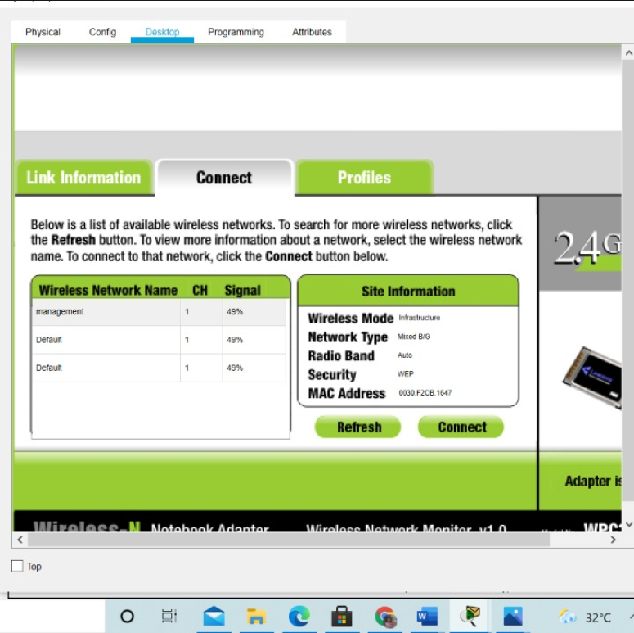
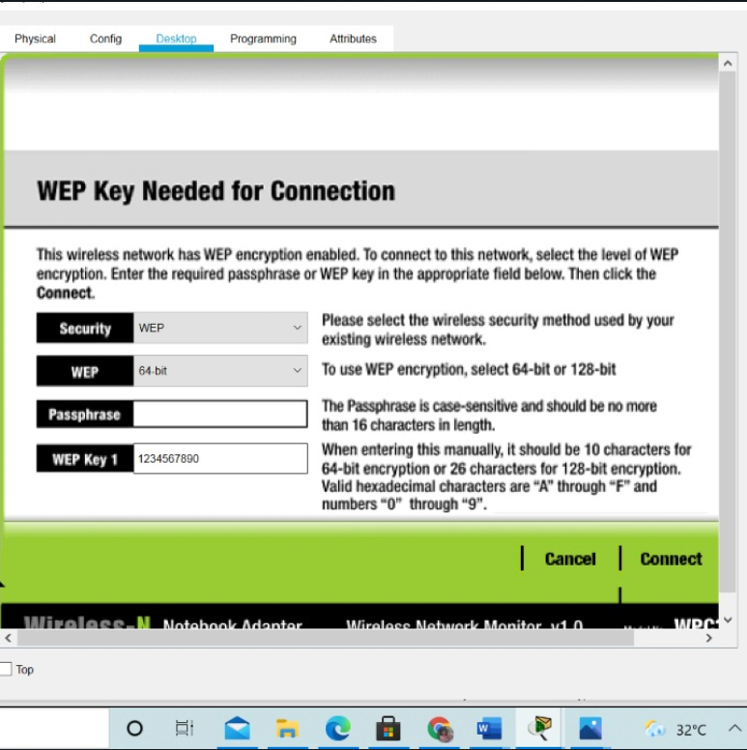
Network Testing & Verification(Cont.)

Slide 13
Conclusion
With the growth of Information Technology in every sector and the explosion of medical IOT
devices, the design of a network of any university has become a very essential factor.
The universities need to have a reliable, secure and scalable network design in order to keep
the students' information, faculty’s research work safe, convenient communication between
various departments, etc. as well as keep it ready for any new IOT l equipment that may be
introduced in the future. Hence we can strive to make the proposed architecture more viable
for future needs.

Slide 14
Bibliography
The University Network - A New Approach Towards Networking Zeeshan Ahmed Siddique
University Network Infrastructure: a Modern Look Into the Network Backbone with Real Time Visibility Homan Mike Hirad

